Slide 1
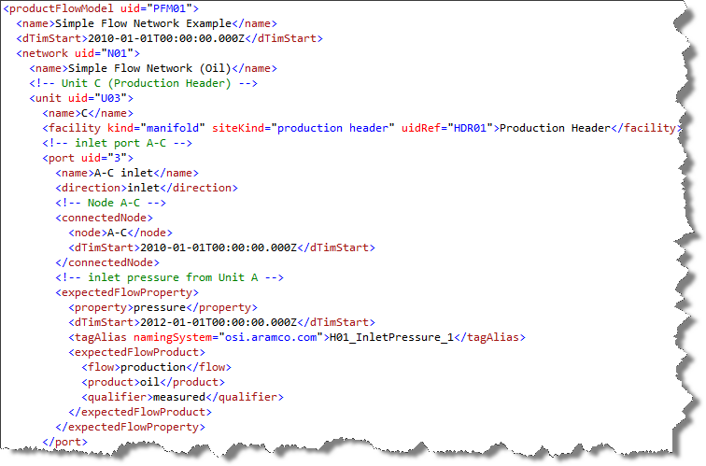
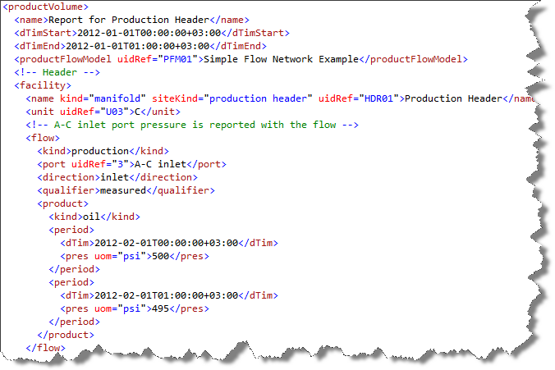
Product Flow Model
Product Flow Model Reference
Product Volume Report

Slide 2
Product Flow Model
Unit Reference
Product Volume Report

Slide 3
Product Flow Model
Port Reference
Product Volume Report

Slide 4
Product Flow Model
Facility Reference
Product Volume Report

